Slide 1
BRET N368S project

Slide 2
Q: What fraction of imatinib resistance-associated mutations in patients are actually not binding to imatinib? (driver vs passenger of resistance)
~1/3 of imatinib resistance-associated mutations still bind imatinib (in HEK293 cells) with similar affinity as Abl wt (as per nBRET assay).
2/3 of imatinib resistance-associated mutations bind imatinib (in HEK293 cells) with weaker affinity than Abl wt (as per nBRET assay).
2/3 of mutants bind to dasatinib; 1/3 also don’t bind to dasatinib
Mutations that don’t bind dasatinib also don’t bind imatinib (with few exceptions).
Q: Could mutations affect cellular binding kinetics of imatinib rather than binding affinity?
Abl N368S (from COSMIC) binds imatinib with similar affinity but cellular dissociation kinetics are 3x faster than wt.
Abl N368S (from COSMIC) binds dasatinib with similar affinity and cellular dissociation kinetics are similar to wt.
Three mutants had ~1.5- fold slower cellular imatinib dissociation kinetics, but similar dasatinib dissociation kinetics to wt.

Slide 3
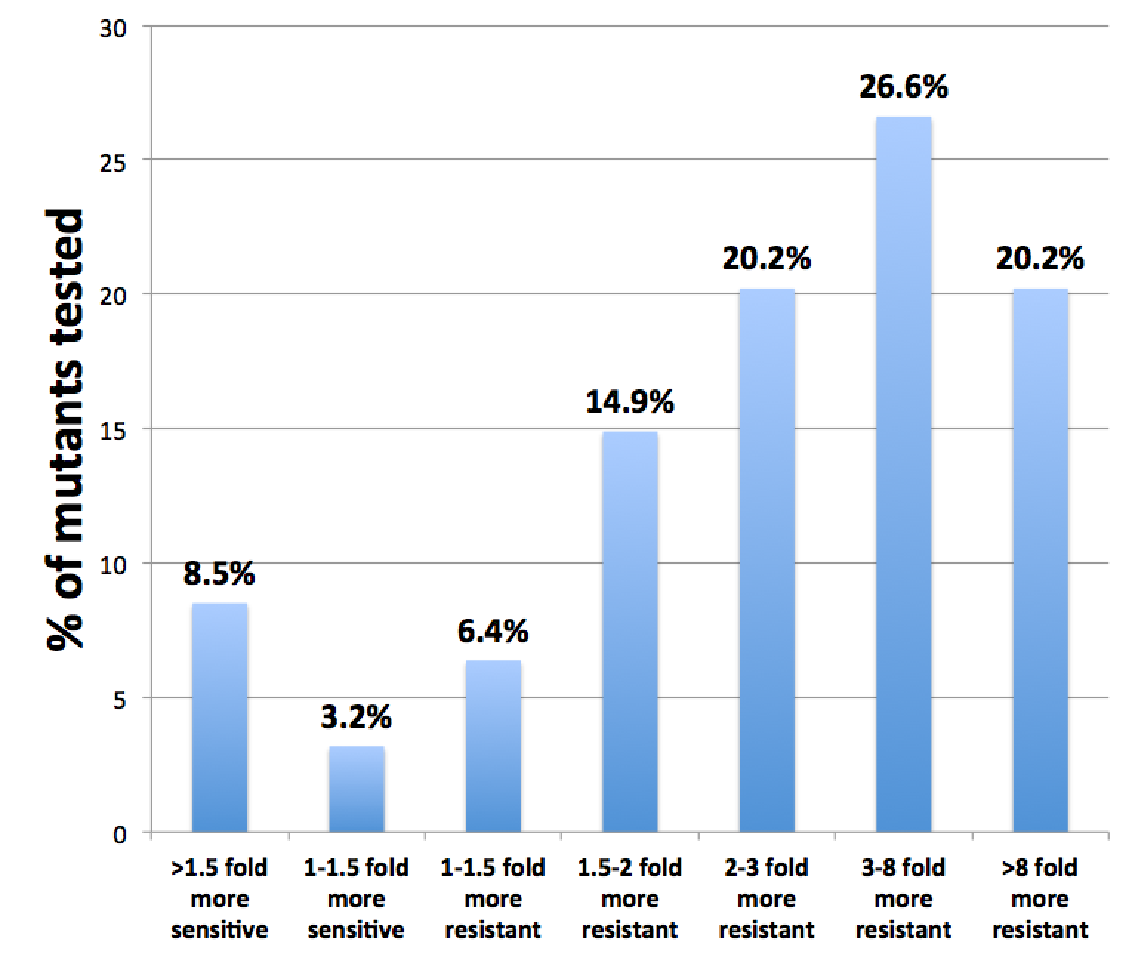
Q: What fraction of imatinib resistance-associated mutations in patients are actually not binding to imatinib? (driver vs passenger of resistance)
~1/3 of imatinib resistance-associated mutations still bind imatinib (in HEK293 cells) with similar affinity as Abl wt (as per nBRET assay).
2/3 of imatinib resistance-associated mutations bind imatinib (in HEK293 cells) with weaker affinity than Abl wt (as per nBRET assay).

Slide 4
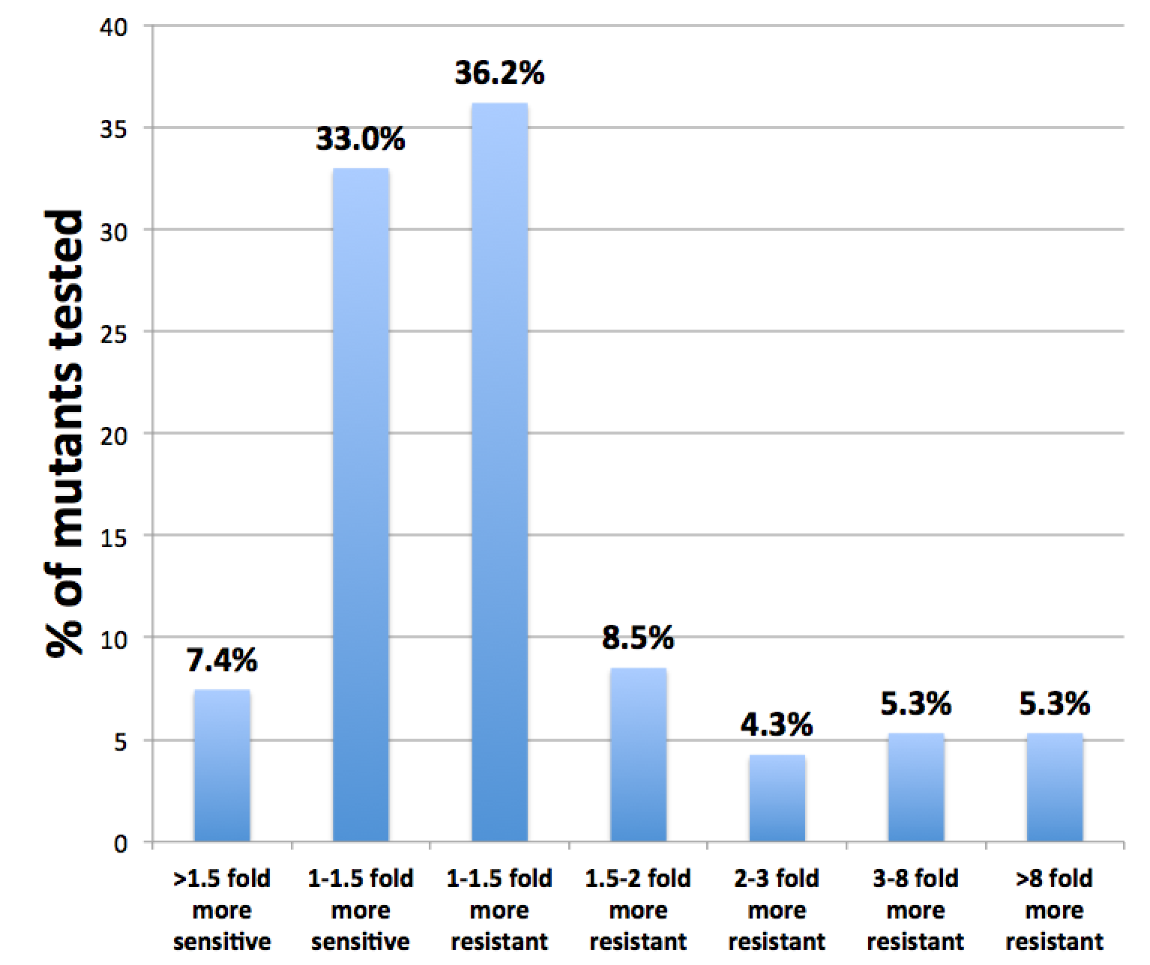
Q: What fraction of imatinib resistance-associated mutations in patients are actually not binding to imatinib? (driver vs passenger of resistance)
2/3 of mutants bind to dasatinib; 1/3 also don’t bind to dasatinib
Mutations that don’t bind dasatinib also don’t bind imatinib (with few exceptions).

Slide 5
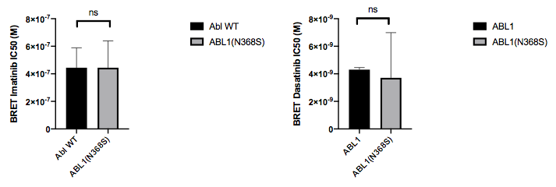
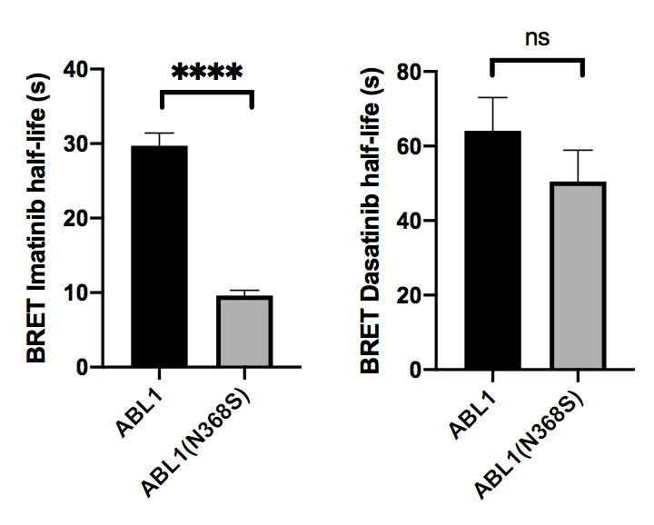
Q: Could mutations affect cellular binding kinetics of imatinib rather than binding affinity?
Abl N368S (from COSMIC) binds imatinib with similar affinity but cellular dissociation kinetics are 3x faster than wt.
**** , p < 0.0001
t_{1/2}= ln2/k_{obs}

Slide 6
Q: Could mutations affect cellular binding kinetics of imatinib rather than binding affinity?
Abl N368S (from COSMIC) binds dasatinib with similar affinity and cellular dissociation kinetics are similar to wt.

Slide 7
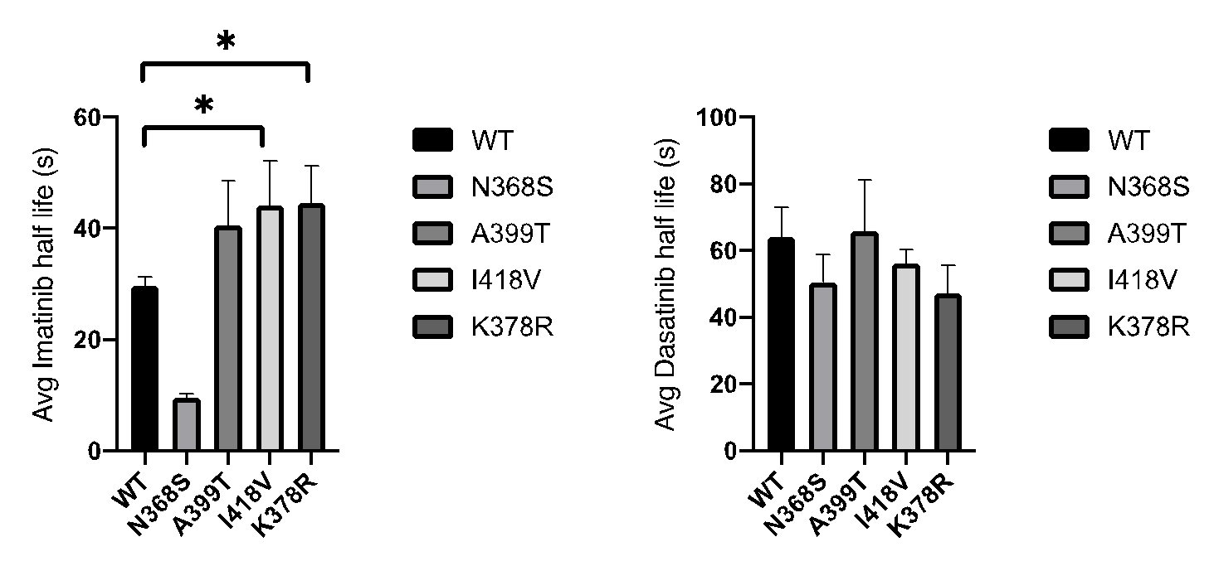
Q: Could mutations affect cellular binding kinetics of imatinib rather than binding affinity?
Three mutants had ~1.5- fold slower cellular imatinib dissociation kinetics, but similar dasatinib dissociation kinetics to wt.
* , p < 0.05
t_{1/2}= ln2/k_{obs}

Slide 8
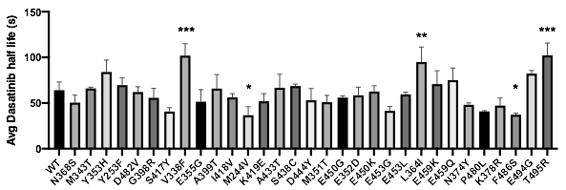
Q: Are dasatinib dissociation kinetics affected by these mutations?
All mutants within 2-fold difference in dasatinib dissociation kinetics to wt.
* p < 0.05, ** p < 0.01, *** p < 0.001, **** p < 0.0001

Slide 9
Q: What is the molecular mechanism by which N368S changes cellular dissociation kinetics but leaves affinity unchanged?
N368S kinase domain shows faster dissociation rates from imatinib in vitro
N368S KD has ~2-fold faster imatinib dissociation kinetics across pH range than wt
N368S kinase domain has similar imatinib binding kinetics compared to wt
Important: pH dependence of imatinib binding kinetics of N368S
N368S KD is not active unless activation loop phosphorylated
Important: What is the affinity of N368S KD for imatinib (e.g. via bosutinib competition)
N368S KD has similar stability as Abl wt
pN368S KD has similar ATP Km as KD of pAbl wt and Abl wt.
Structure of N368S is ongoing
Important: Cellular resistance of BCR-Abl N368S in BaF3 cells is ongoing
NMR of N368S KD is ongoing
N368D KD (MSKCC mutant database) - have DNA

Slide 10
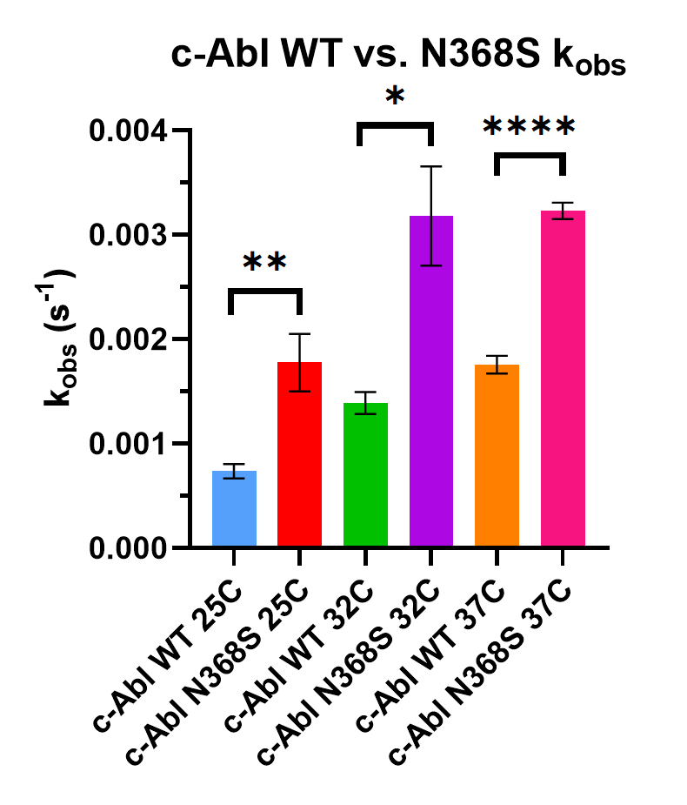
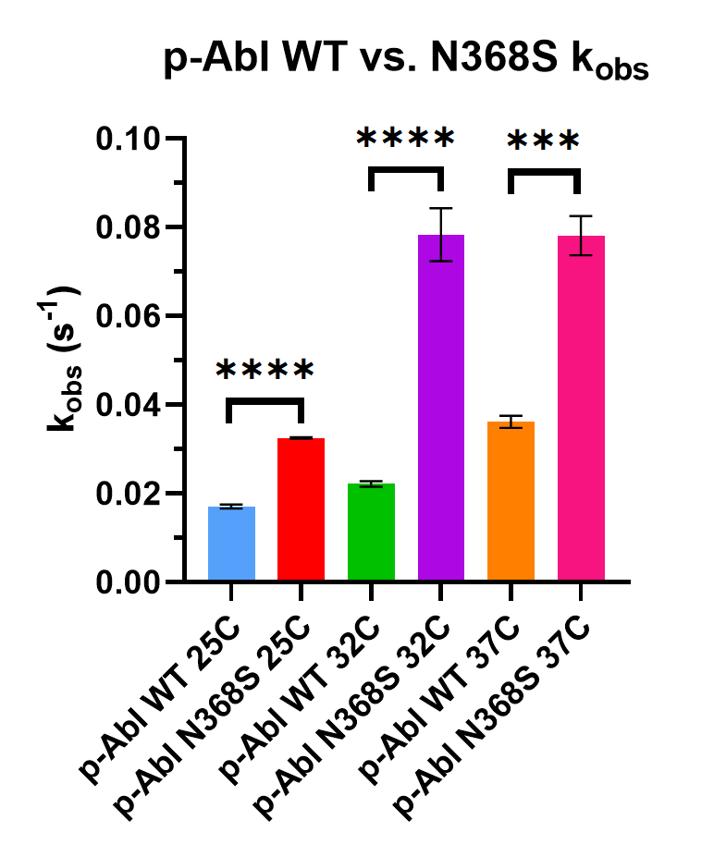
Q: What is the molecular mechanism by which N368S changes cellular dissociation kinetics but leaves affinity unchanged?
N368S kinase domain shows faster dissociation rates from imatinib in vitro
* p < 0.05, ** p < 0.01, *** p < 0.001, **** p < 0.0001

Slide 11
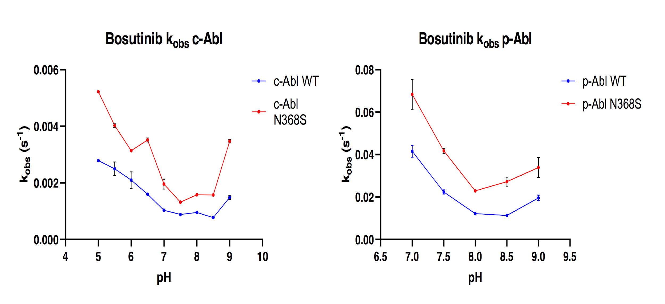
Q: What is the molecular mechanism by which N368S changes cellular dissociation kinetics but leaves affinity unchanged?
N368S KD has ~2-fold faster imatinib dissociation kinetics across pH range than wt

Slide 12
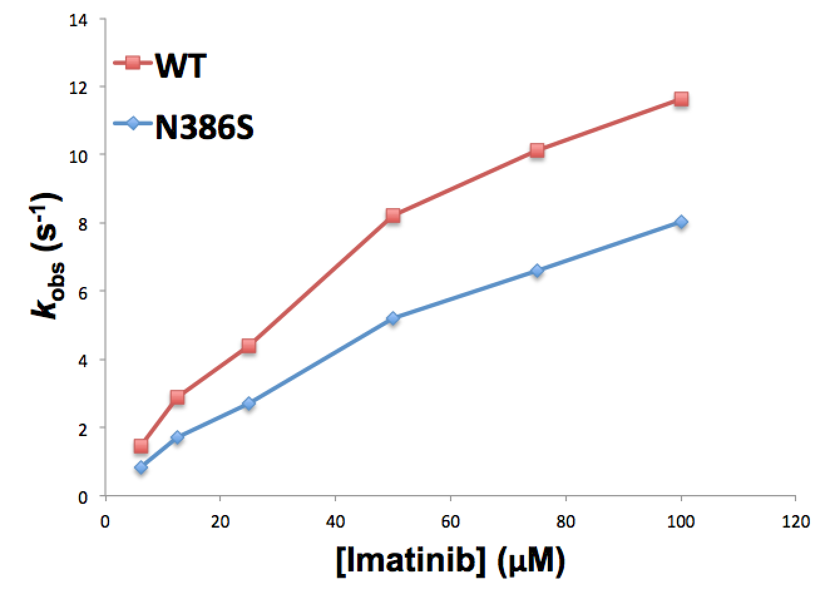
Q: What is the molecular mechanism by which N368S changes cellular dissociation kinetics but leaves affinity unchanged?
N368S kinase domain has similar imatinib binding kinetics compared to wt

Slide 13
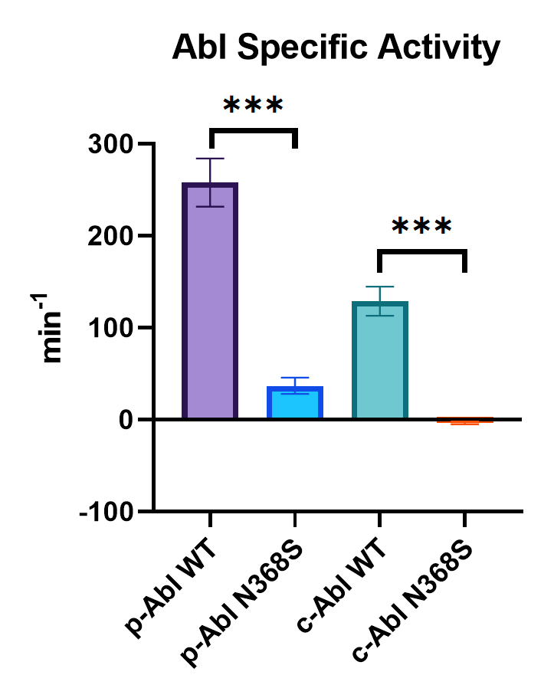
Q: What is the molecular mechanism by which N368S changes cellular dissociation kinetics but leaves affinity unchanged?
N368S KD is not active unless activation loop phosphorylated
* p < 0.05, ** p < 0.01, *** p < 0.001, **** p < 0.0001

Slide 14
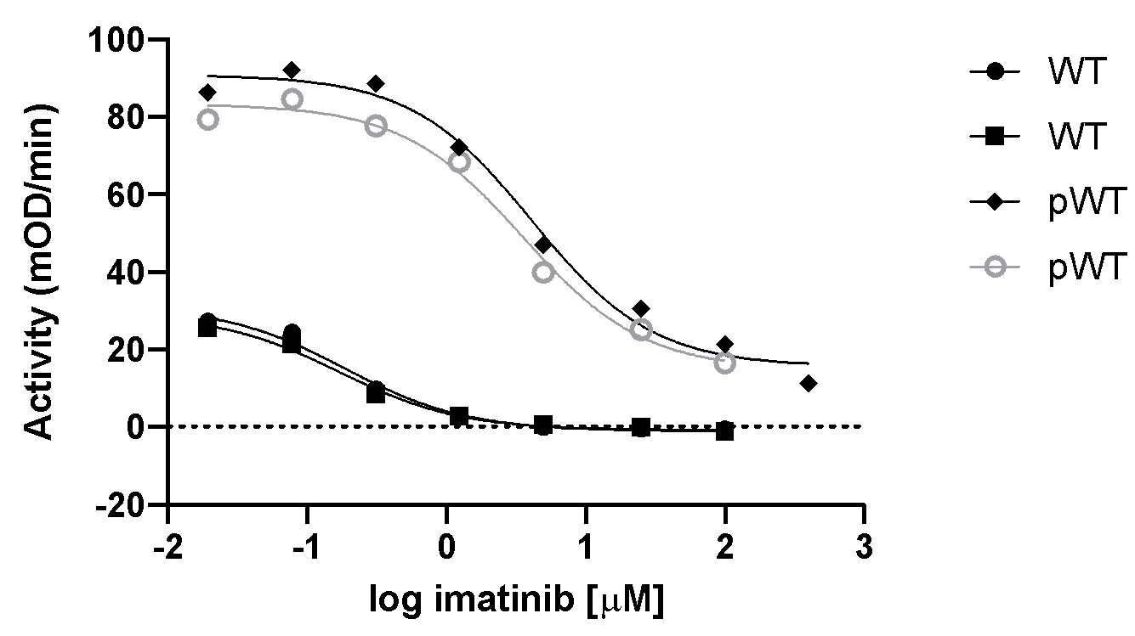
Q: What is the molecular mechanism by which N368S changes cellular dissociation kinetics but leaves affinity unchanged?
Important: What is the affinity of N368S KD for imatinib (e.g. via bosutinib competition)
Need to repeat pN368S

Slide 15
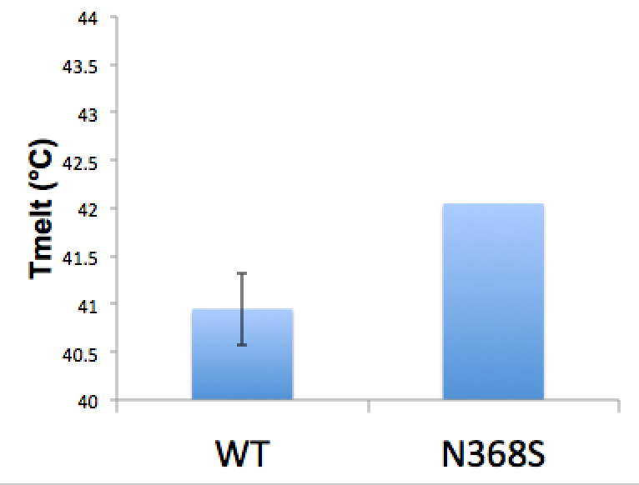
Q: What is the molecular mechanism by which N368S changes cellular dissociation kinetics but leaves affinity unchanged?
N368S KD has similar stability as Abl wt

Slide 16
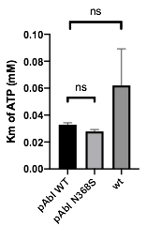
Q: What is the molecular mechanism by which N368S changes cellular dissociation kinetics but leaves affinity unchanged?
pN368S KD has similar ATP Km as KD of pAbl wt and Abl wt.

Slide 17
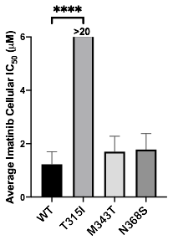
Q: What is the molecular mechanism by which N368S changes cellular dissociation kinetics but leaves affinity unchanged?
BCR-Abl N368S expressing BaF3 cells remain sensitive to imatinib.

Slide 18
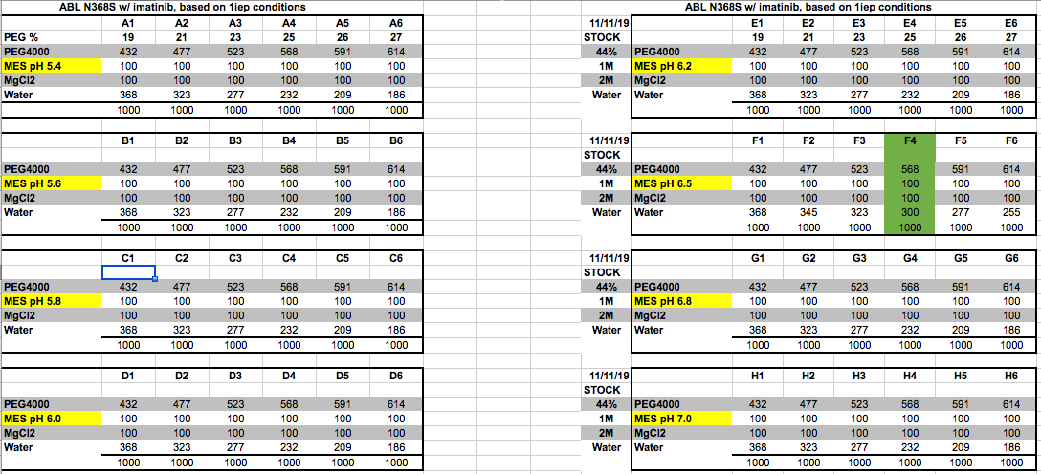
Q: What is the molecular mechanism by which N368S changes cellular dissociation kinetics but leaves affinity unchanged?
Structure of N368S is ongoing
NMR of N368S KD is ongoing
N368D KD (MSKCC mutant database) - have DNA
Crystal tray screen

Slide 19
To ask John:
Where are we with the simulations of N368S?
Are there any differences in the dynamic signatures of Abl N368S and Abl wt?
Any pointers at the mechanism of why N368S would dissociate faster from imatinib?
How is the DFG-in/out ratio in N368S relative to wt?
Any word from Pratyush regarding the dissociation kinetics?

